Slide 1
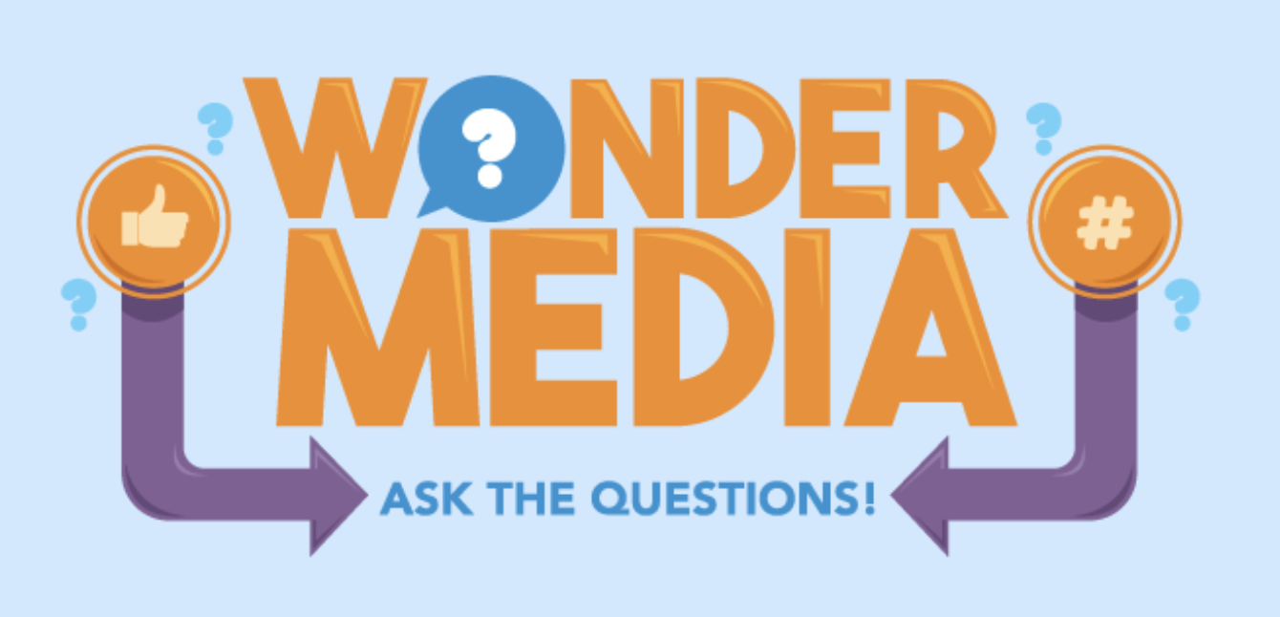
Example of Wonder Media Library Programming
Features an original song by four Kalamazoo-area artists
Focuses on the media literacy concepts that media messages convey specific values, lifestyles or points of view; and different people experience the same message differently.
Encourages critical analysis by tweens and teens of content
Utilizes the engaging format of music to appeal to target audience
Incorporates various learning styles – visual, kinetic, auditory
Encompasses digital games on WML.org, lesson plans and in-person discussions.

Slide 2

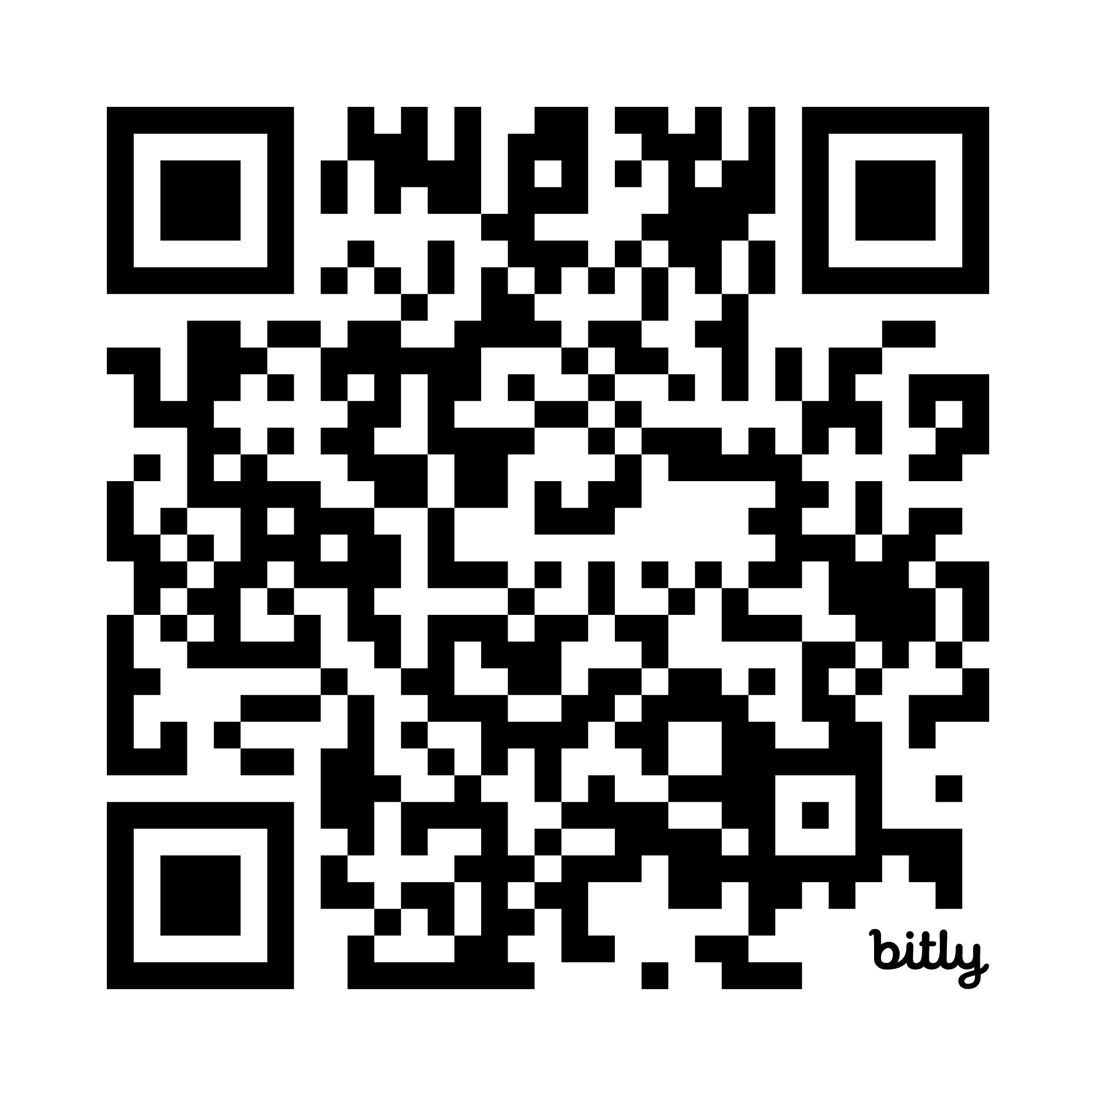
“Whose Story is It Anyway?”
By Lady Ace Boogie, Nathan Moore, Álvaro Paz and Carla Fernández-Soto
Lyrics: https://bit.ly/4khSAoK
Link to song on Spotify: https://bit.ly/4lIzXKU
Chorus:
Is it you? It is me? Is it her?
Is it them? Is it they? Is it us?
Whose story is it anyway?

Slide 3
“Whose Story Is it Anyway?”
V3/Alvaro (English translation):
In the world, only you know what you've been through.
Don't let them speak for you about what you've suffered.
You must be the one who tells your own story.
Don't let fear grow and erase your memory.
And remember...
You must never be silent.
Never, ever.
You must never be silent.
Not even to breathe.
V4/Carla (English translation):
Let me tell you a story.
Once upon a time...
My first “big girl” job
meeting with a higher up
All is chill until she unarms me
"Oh wow, you're smarter than you look"
Was it my brown skin?
Was it my young age?
Was it my amapola red-painted lips?
What do you know about me?
Don't underestimate me!
Don't underestimate me!
V1/Lady Ace:
Whoever you are, whatever you do, whatever you feel, whatever you choose. However you move, end of the day it’s all in you.
Shake up the world with it. Elevate straight up off the floor with it. High as the sky there ain’t no limits.
You were born with it... Look in the mirror who you see. Hopefully it’s the human that you’re destined to be. Hopefully you can see what the rest of us see. I’m talking to you but I’m also talking to me.
A whole lot of affirmation manifesting is key; get you to your destination - it’s the hustle for me. It’s the way you go and get it. t’s the tussle for me. Gotta grind move ya muscle, don’t you buckle ya knees.
Stay consistent pay attention cause this knowledge is free. Open you mind and your heart gotta tap in your chi. When your energy is low don’t forget you can breathe. And when your energy is high show the world who you be.
Spread the love if you got it don’t get caught up in greed. Woot yeah, don’t get caught up in greed, show the world who you be.
V2/Nathan: I am more than the world can see. Believe in me. Listen to what I have to say. Believe in me. We are more than the world can see. Believe in me. Listen to what we have to say. Believe. And let me be. Said let me be. Let me be. Let me be. Let me be.

Slide 4
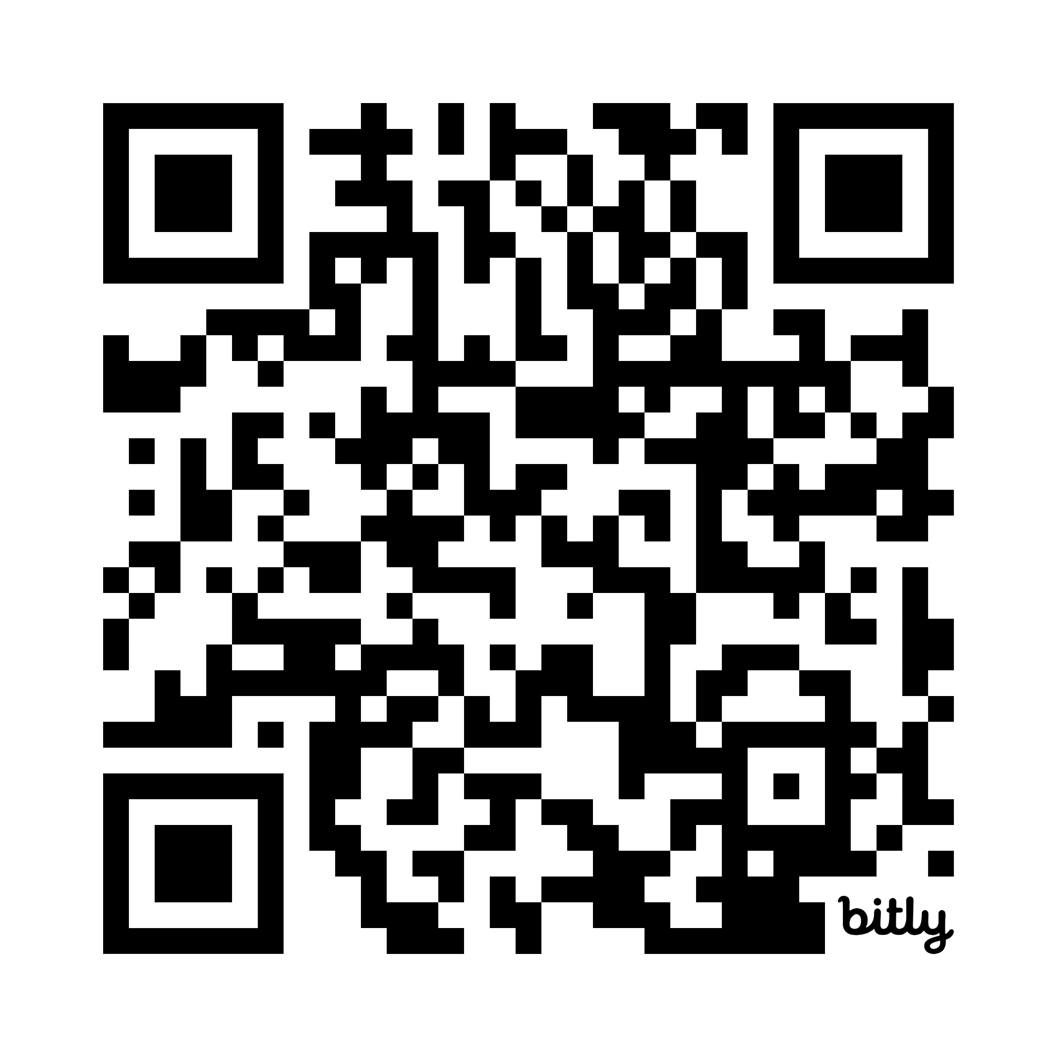

Programming Ideas for “Whose Story Is It Anyway?”
Write your own verse for Whose Story Is It Anyway?
Pick one of the four instrumental tracks that underlie the lyrics by each of the four performers. Write your own lyrics and lay down your vocals over the instrumental. (You might want to share your work on social media, but make sure you credit the original with a link to the published song.) The QR code here links to the instrumental tracks.
Think about how your words fit with the beat and instrumentals of the song. Imagine trying to write a country music song or a patriotic song to the tracks provided. What are some of the codes and conventions that prompt you to approach your song lyrics in one way and not another?
Notes:
A creating is part of media literacy. Allowing youth to tell their story of media portrayals is powerful.

Slide 5
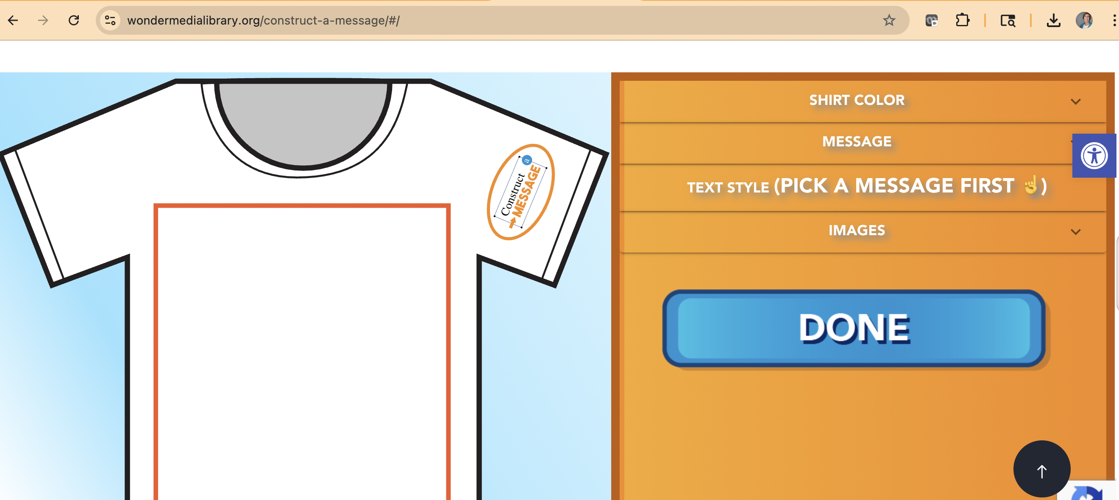
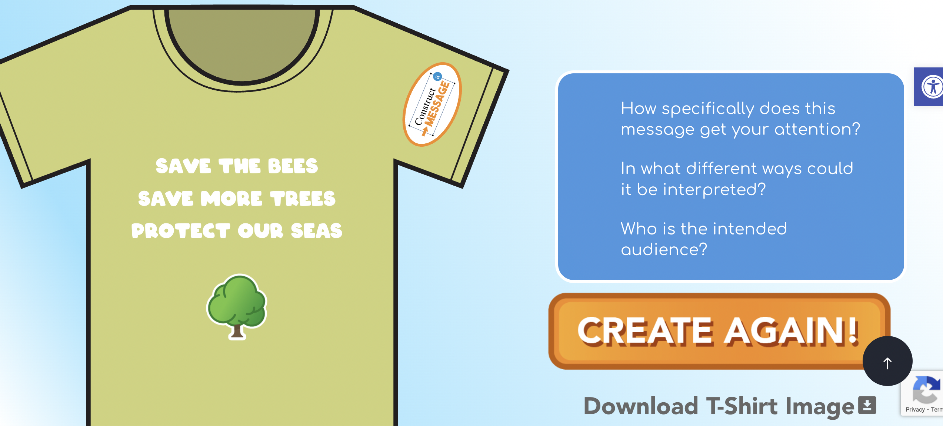
Construct a Message website game

Slide 6

Programming Ideas for “Whose Story Is It Anyway?”
Watch a few of the videos showcased on the Whose Story Gets Told? page of wondermedialibrary.org. Think about how media (movies, TV, advertising, videos, news and more) portray the lives of various groups of people based on social categories such as race/ethnicity, nationality, age/generation, gender, sexual orientation, educational background and more.
How accurate are those portrayals?
How are groups you belong to depicted in media representations?
What ideas and concepts do you hold about other people who you don’t know personally but only know about from representations in the media?
Relate this learning to the song “Whose Story Is it Anyway?” What are each of the four singers saying about how media tell their stories?
Notes:
This was the favorite exhibit at the museum. More than 4,000 cards were completed about how participants’ stories get told.

Slide 7
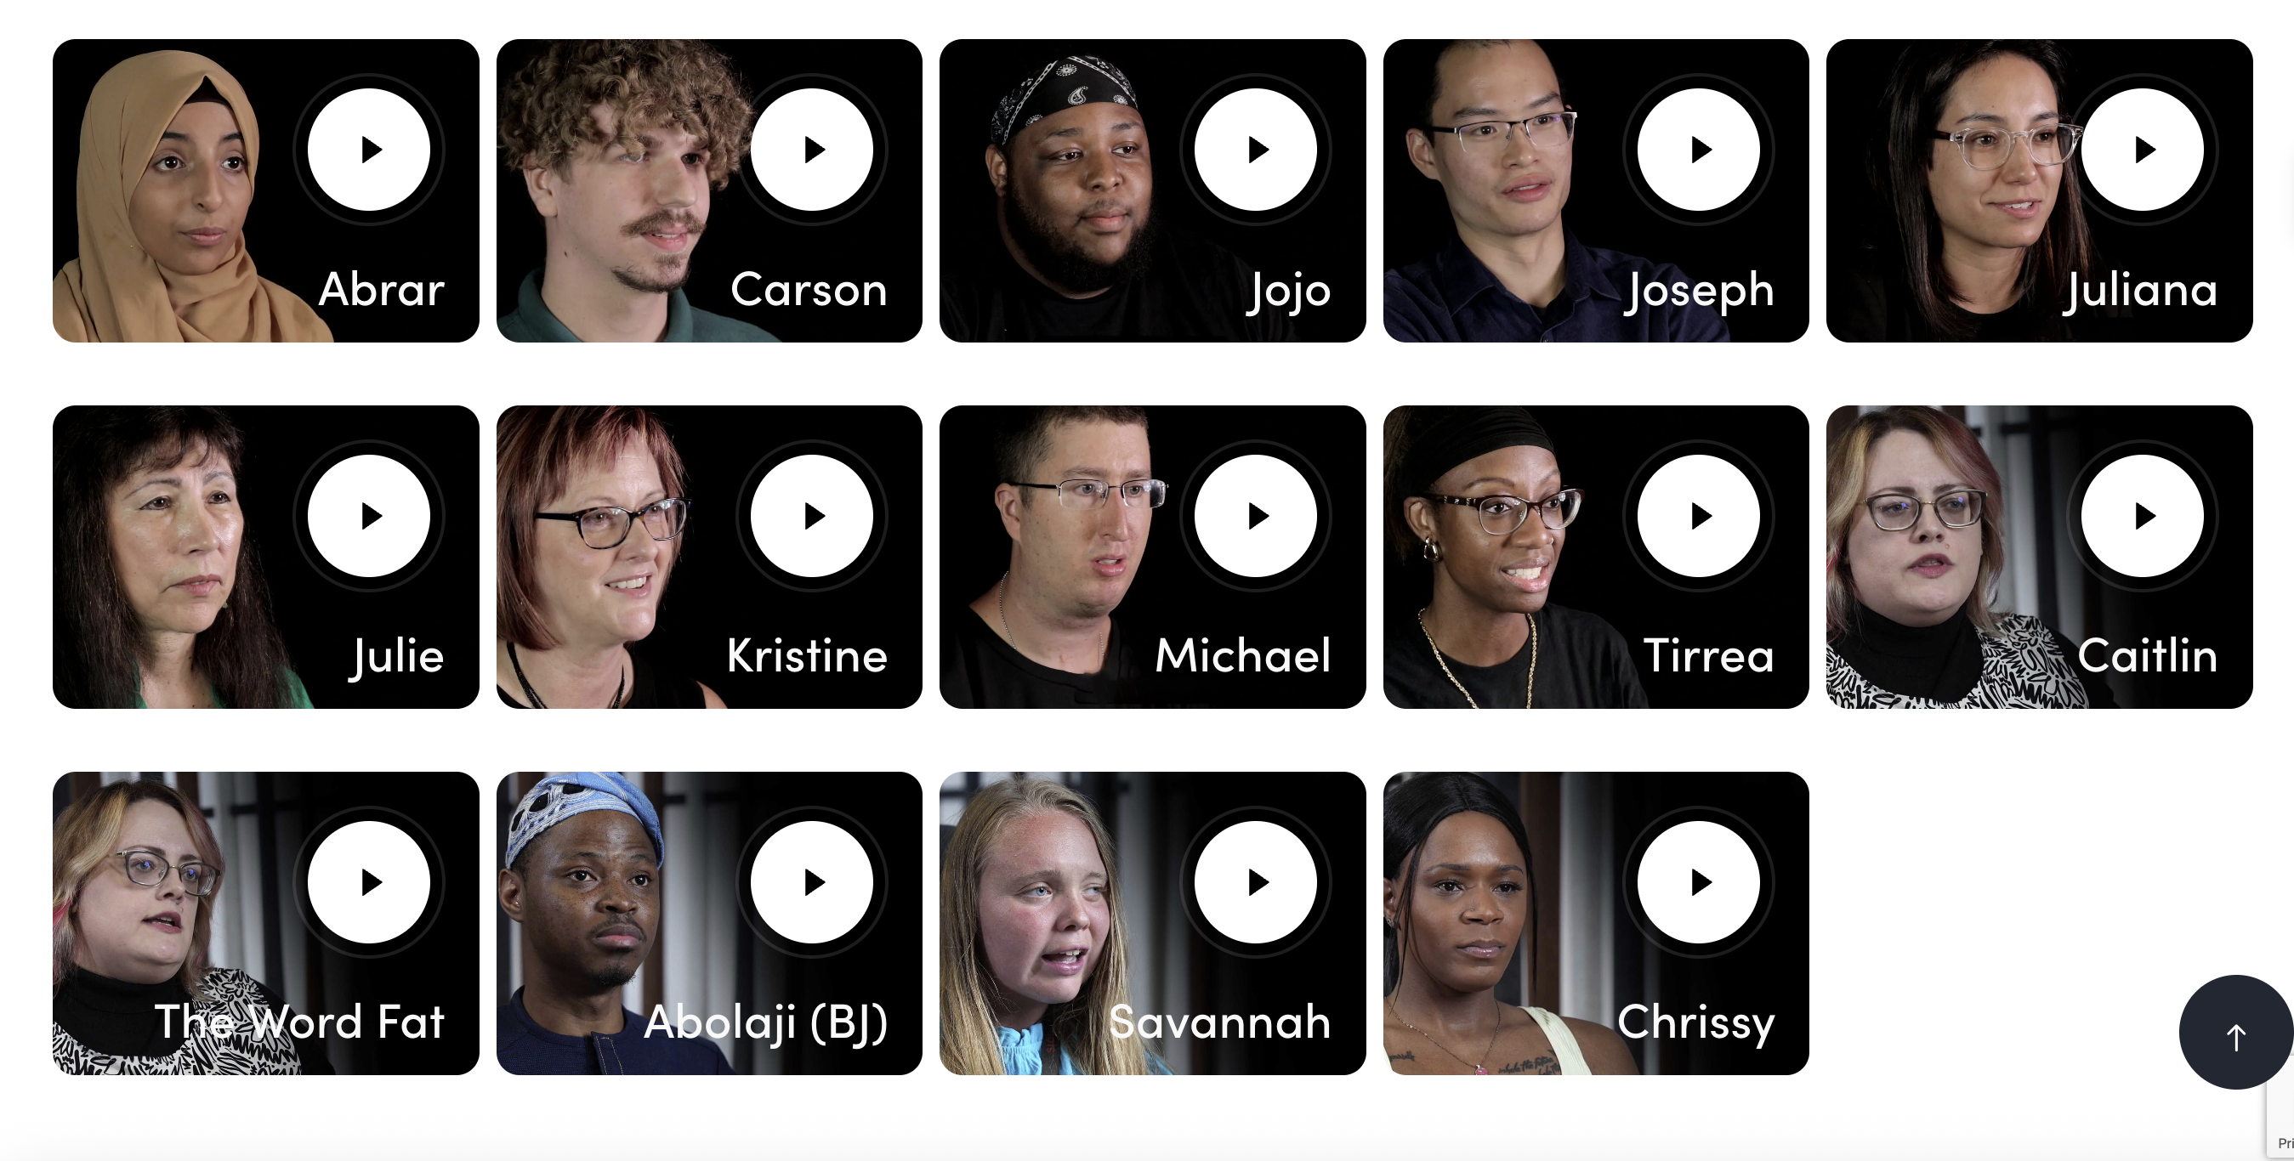
Whose Story Website Videos

Slide 8
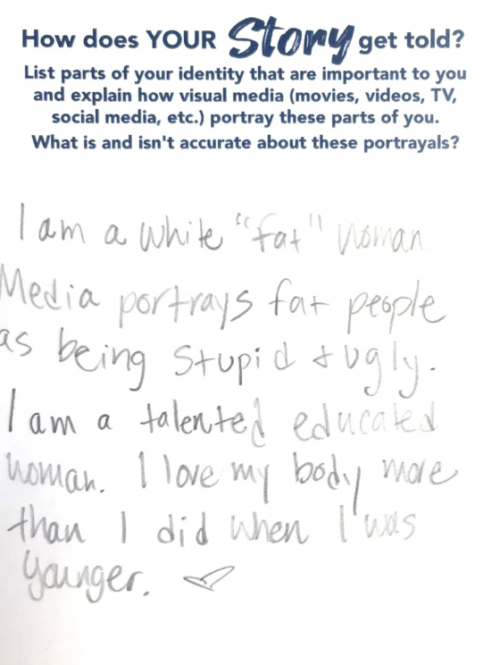
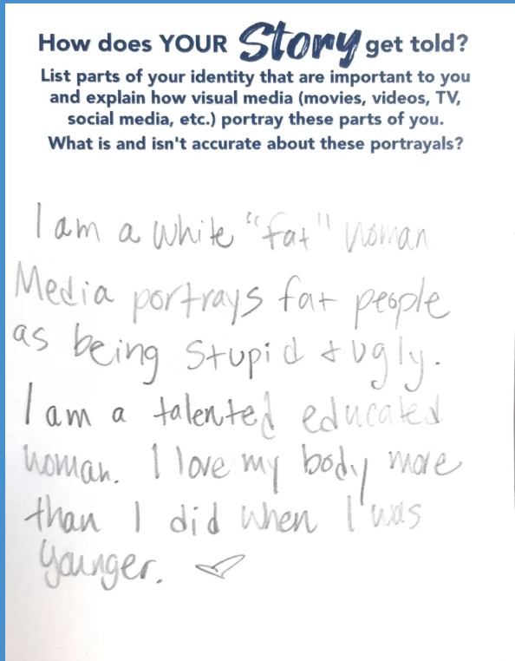
Whose Story Gets Told user-completed cards

Slide 9
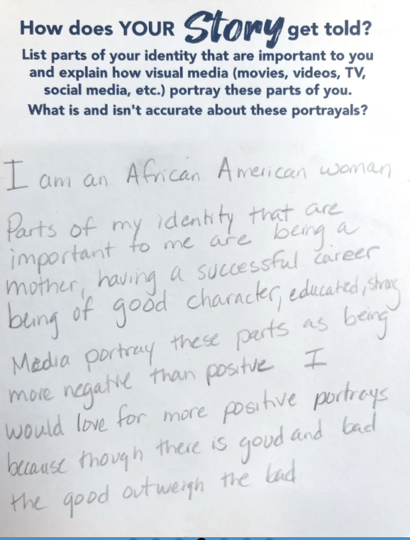
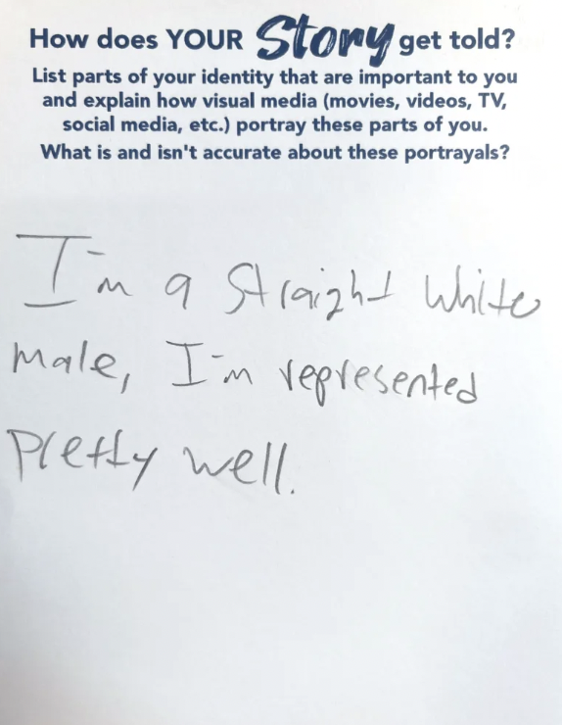
Whose Story Gets Told user-completed cards

Slide 10
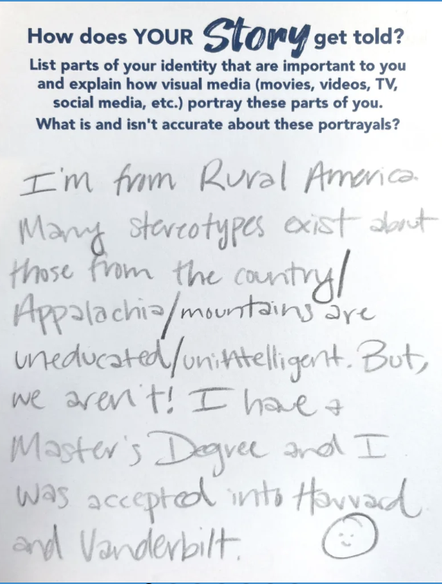
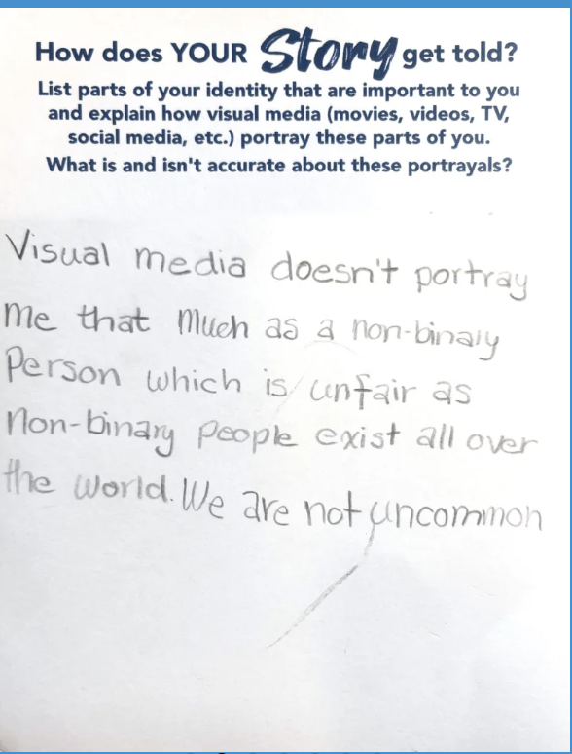
Whose Story Gets Told user-completed cards

Slide 11

Programming Ideas for “Whose Story Is It Anyway?”
If you were in charge of a major media company, what would you do to change the way that media messages portray various groups of people in society?
Visit the If I Were a Media Boss page on wondermedialibrary.org and read a few of the more than 2,000 hand-written cards that visitors to Wonder Media have written with their programming ideas! Do you like any of the ideas presented? Why or why not?
Notes:
Giving youth ownership of the process. They have choices and more control the more they learn about the manipulative factors of social media.

Slide 12
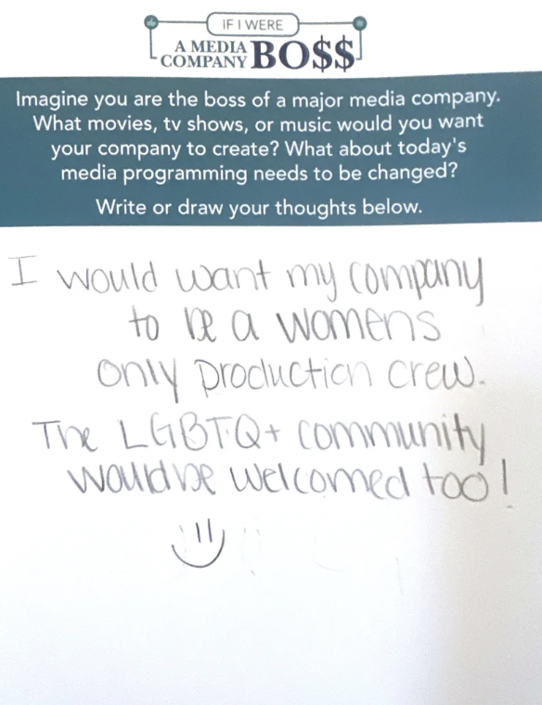
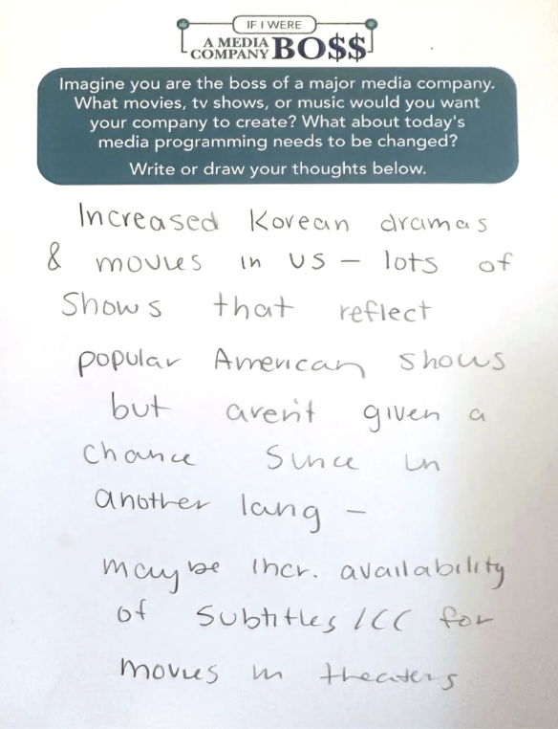
If I Were A Media Boss user-completed cards

Slide 13
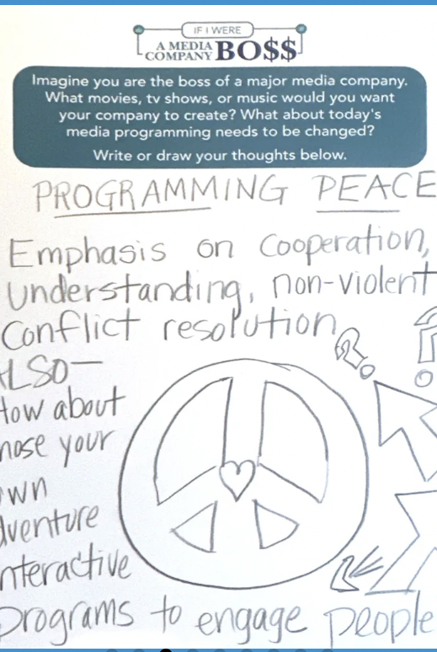
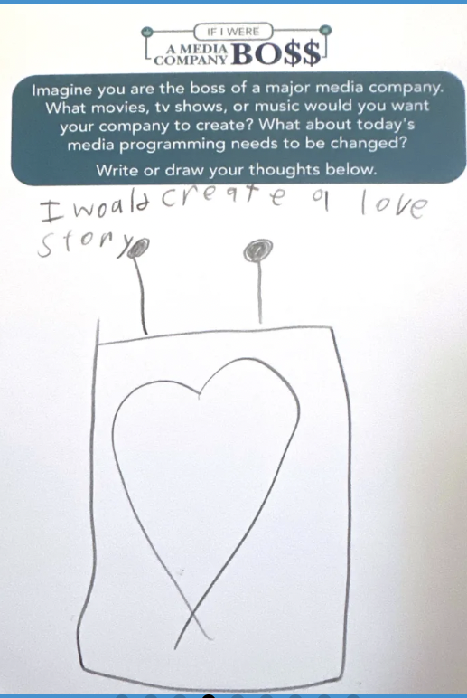
If I Were A Media Boss user-completed cards

Slide 14
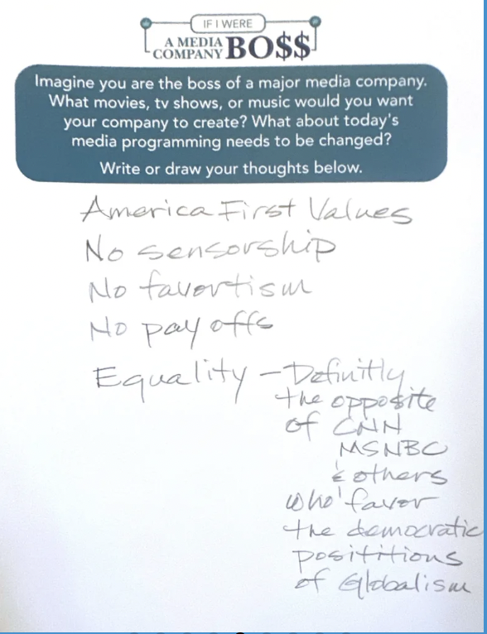
If I Were A Media Boss user-completed cards

