Slide 1
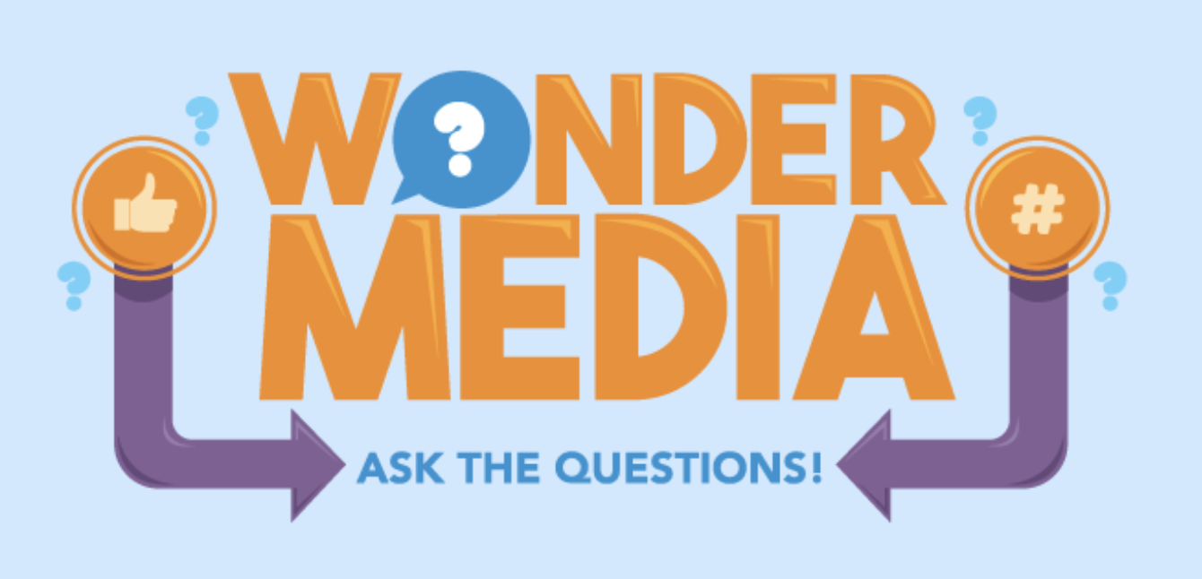
Example of Wonder Media Library Programming
Features an original song by Nashville artist Rachael Davis
Focuses on the media literacy concepts that media messages convey specific values, lifestyles or points of view; and that all media messages are created for profit or power
Encourages critical analysis by tweens and teens of content
Utilizes the engaging format of music to appeal to target audience
Incorporates various learning styles – visual, kinetic, auditory
Encompasses digital games on WML.org, lesson plans and in-person discussions.

Slide 2
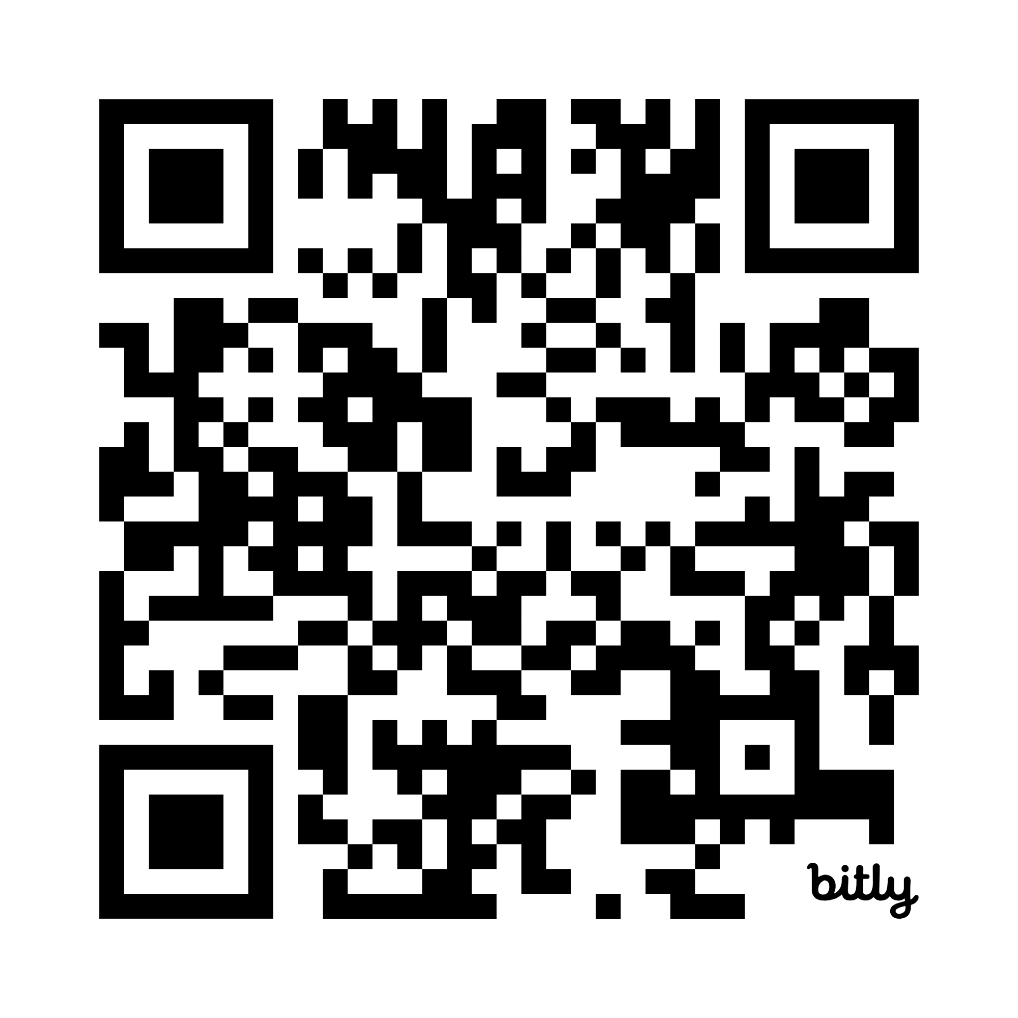

“Dreamer” by Rachael Davis for Click: The Musical. Connect IRL
Lyrics: https://bit.ly/45DnG5H
Song on Spotify: https://bit.ly/4nV8IPt
Chorus:
Darlin’ you were born a dreamer
Now let those dreams come through
Remember that you are the shining star
That makes your wish come true
https://www.rachaeldavis.com/
Notes:
These are

Slide 3
“Dreamer” https://bit.ly/4nV8IPt
V1 Everyone is born a dreamer
and all our dreams are in plain sight
They’re in front and all around us
and in them we take flight
Oh as we grow and as we and learn
about the world where we all live
Sometimes the weight of what we witness
can cause our wings to give.
V2 So in this brave new world be mindful
Because sometimes what we need
Can be so hard to recognize, dear
In a web of want and greed
V3 Now please be sure that you’re a beauty
and you’re strong and smart and kind.
When the influence of strangers
tangles up your precious mind
When the illusions of perfection
are shining like a star
Take a look at your reflection
and remember who you are
Notes:
A song to encourage one’s own dreams, not those presented as perfect by others.

Slide 4
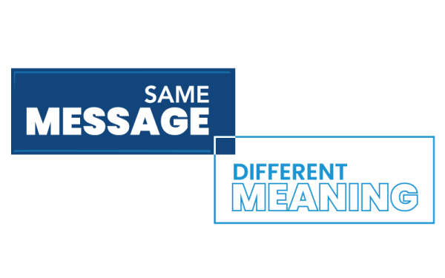
Programming Ideas for “Dreamer”
Visit the Same Message/Different meaning page on wondermedialibrary.org. How might different people understand this same musical message? Discuss with a peer what this song means to each of you or how it makes you feel.
What is the effect of your media use on the dreams and goals you have?
Where do you find inspiration online and what sites or platforms bring you down or lower your sense of self? Make a list. Discuss with others some ways you might shape your media use to best support your dreams.

Slide 5
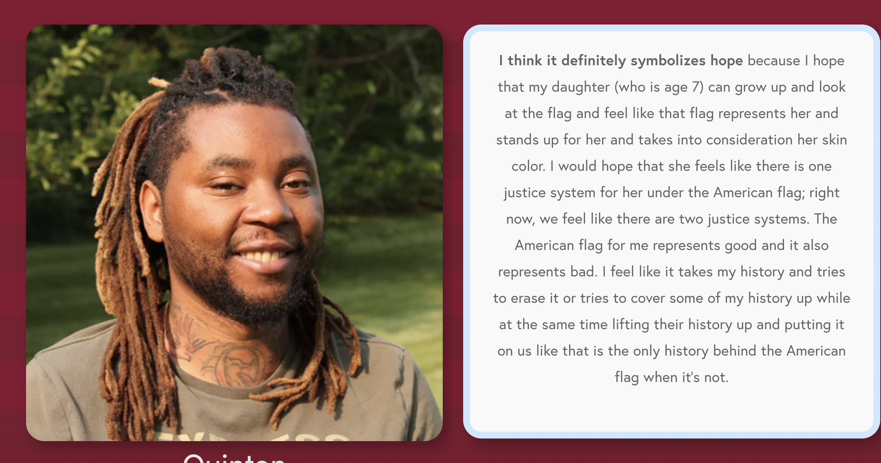
“Same Message Different Meaning” WML website game: “What does the U.S. flag mean to you?”

Slide 6

Programming Ideas for
“Dreamer”
What is the message of this song?
Where do you see references to media in this song’s lyrics?
Visit the Daily Media Use game on wondermedialibrary.org to see how your media use compares with others. Look on the Settings on your phone to check on your daily screen time and where you spend it.

Slide 7
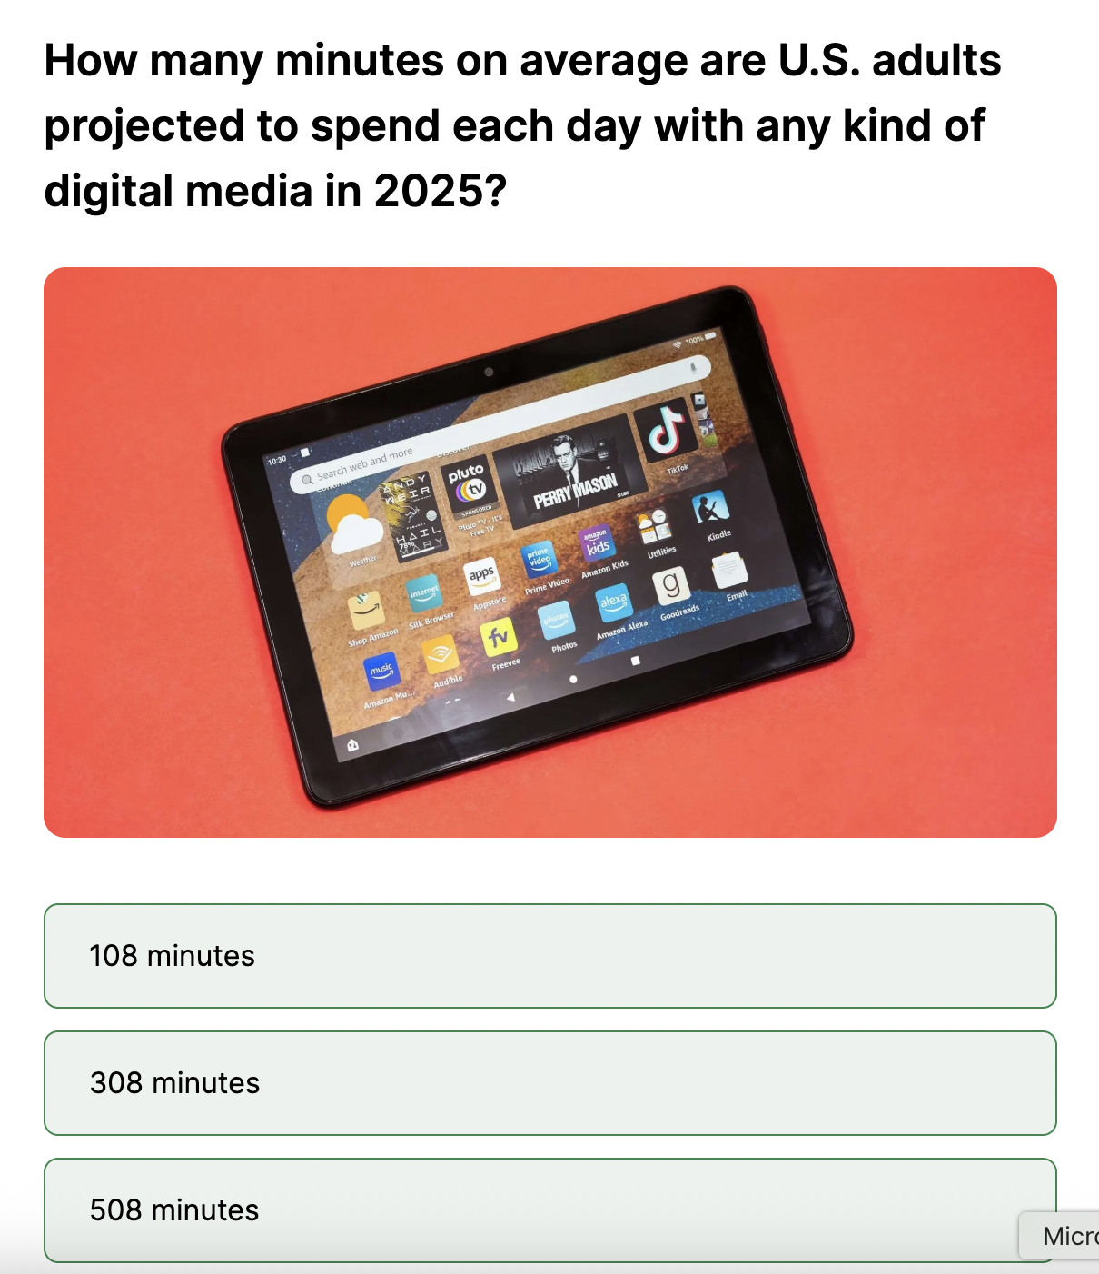
Daily Media Use website game

