Slide 1
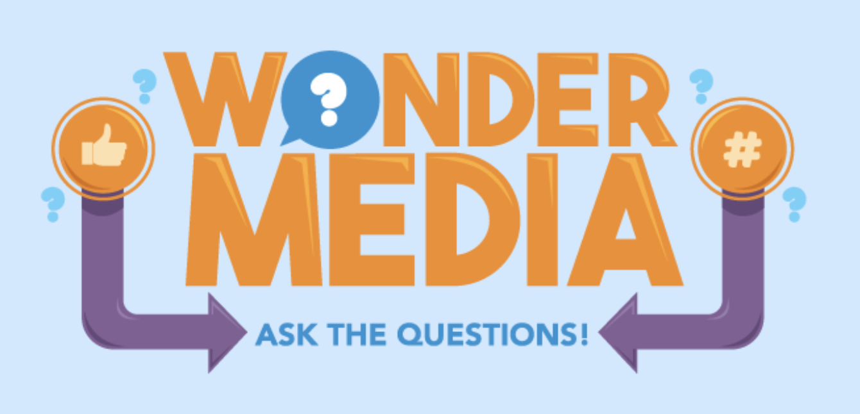
Example of Wonder Media Library Programming
Features an original song called “American Lyricism” by Kalamazoo musician Jeff Moehle
Focuses on the media literacy concepts that media messages convey specific values, lifestyles or points of view; and that all media messages are created for profit or power
Encourages critical analysis by tweens and teens of content
Utilizes the engaging format of music to appeal to target audience
Incorporates various learning styles – visual, kinetic, auditory
Encompasses digital games on WML.org, lesson plans and in-person discussions.

Slide 2
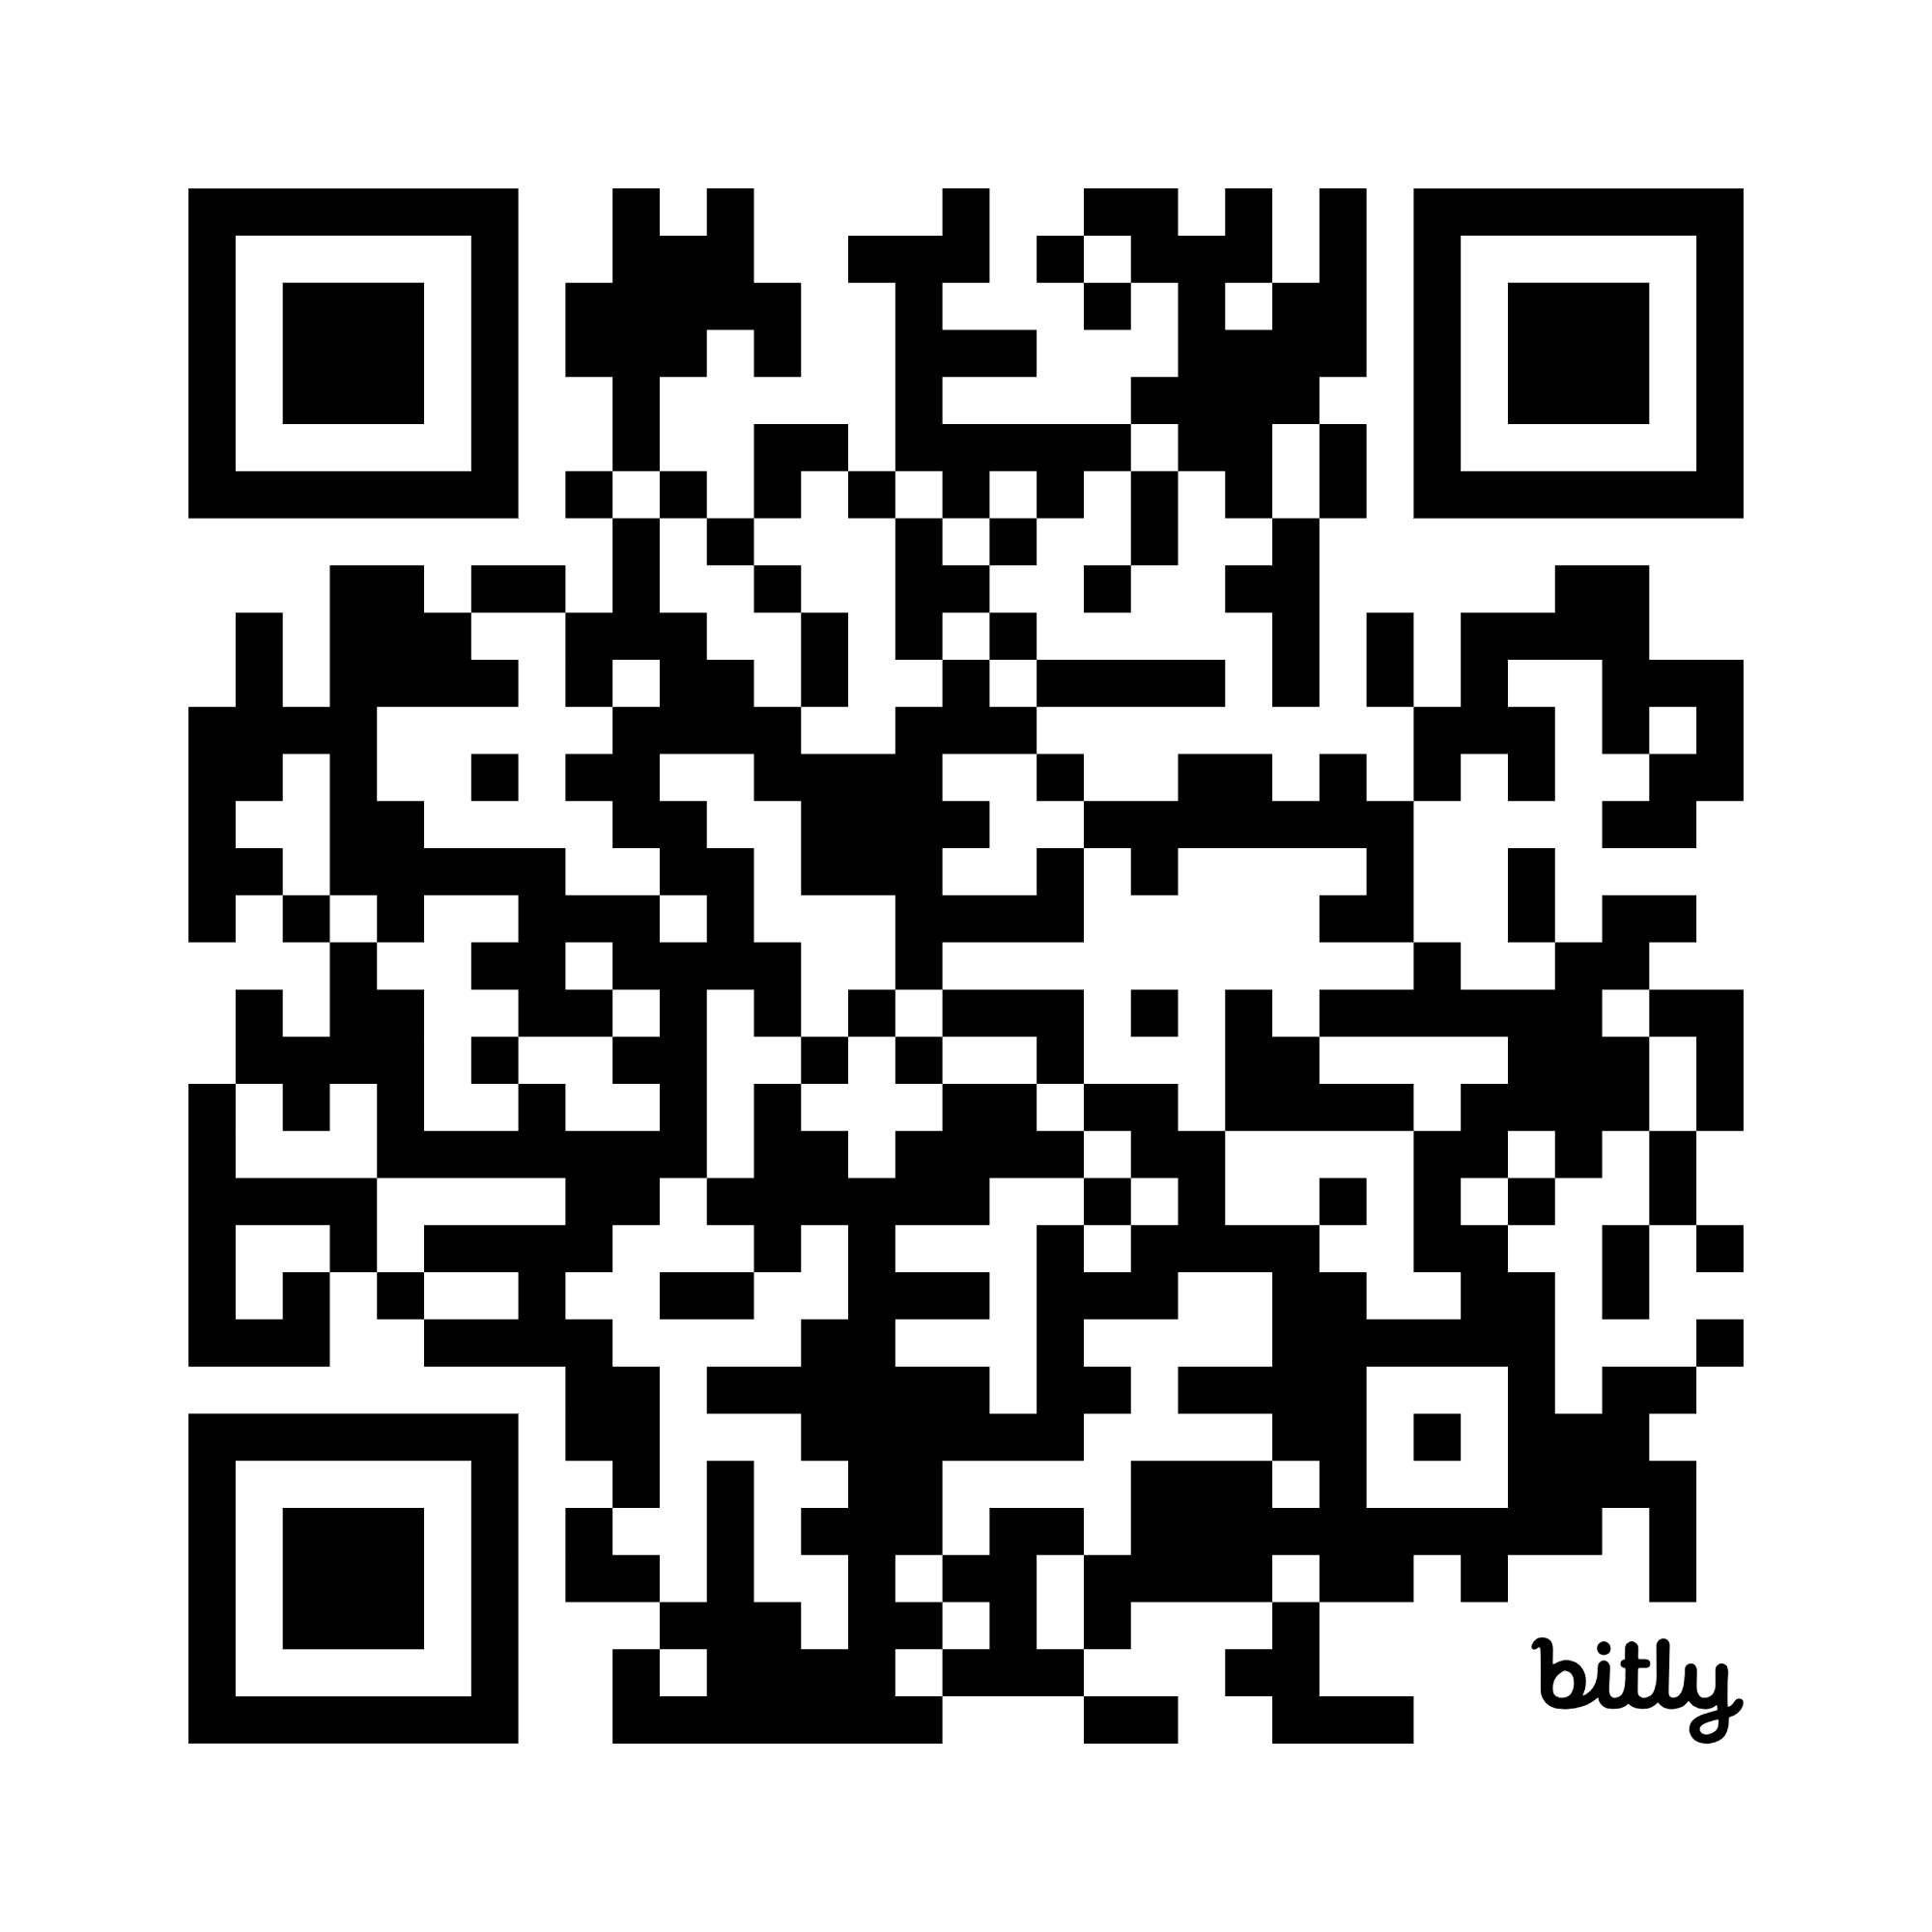

“American Lyricism” by Jeff Moehle
Lyrics: https://bit.ly/3SBtqFs
Link to song on Spotify: https://bit.ly/46tGKUs
Chorus:
Mix up the beat
Take to the street
Say it loud:
We won’t retreat
We’re feeling strong and feeling proud.
Cuz we believe that we all share the same heart–
We are a part of everyone.
https://jeffmoehle.com/
Notes:
One of the themes that we see in data on youth media use is that they are on devices all day long. They have cut their FtF interactions substantially in lieu of FaceTime or group gaming or Insta chats. This song invites listeners to think about what they are gaining from this lifestyle and what they are losing, and appeal to a sense of teenage rebellion.

Slide 3
“American Lyricism” https://bit.ly/46tGKUs
V1 We get our news through a piece of glass
and we never even think to ask
Is it true or is it fiction?
Bogged down in the metrics of the system.
Yeah, we want to live without the lies
Coexist in a paradise,
But we gotta put the work in
Wise choices to resist the next suggestion,
Cuz truth isn’t the idea they’re suggesting.
There’s no telling where the next threat is coming
No telling when the next threat is coming
V2 Everybody wants to think they’re right
No challenge means you always win your own fight
But with partial information
Is anyone, anyone really winning?
Still we try to get the upper hand
And choose pride over kindness
Yeah, we’re cast in a play
Written by fools for profit and gain
They get the money, we get the pain.

Slide 4
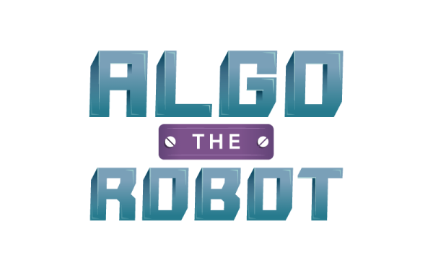
Programming Ideas for “American Lyricism”
Visit the Algo the Robot page on wondermedialibrary.org. What is an algorithm? How do algorithms affect your life online? How do algorithms affect your life offline? Where in the song do you hear algorithms referenced?
The song called “American Lyricism” was also titled “The Anti-Algorithm Song.” Which title do you think better fits the lyrics and why?
Notes:
“Bogged down in the metrics of the system.”

Slide 5
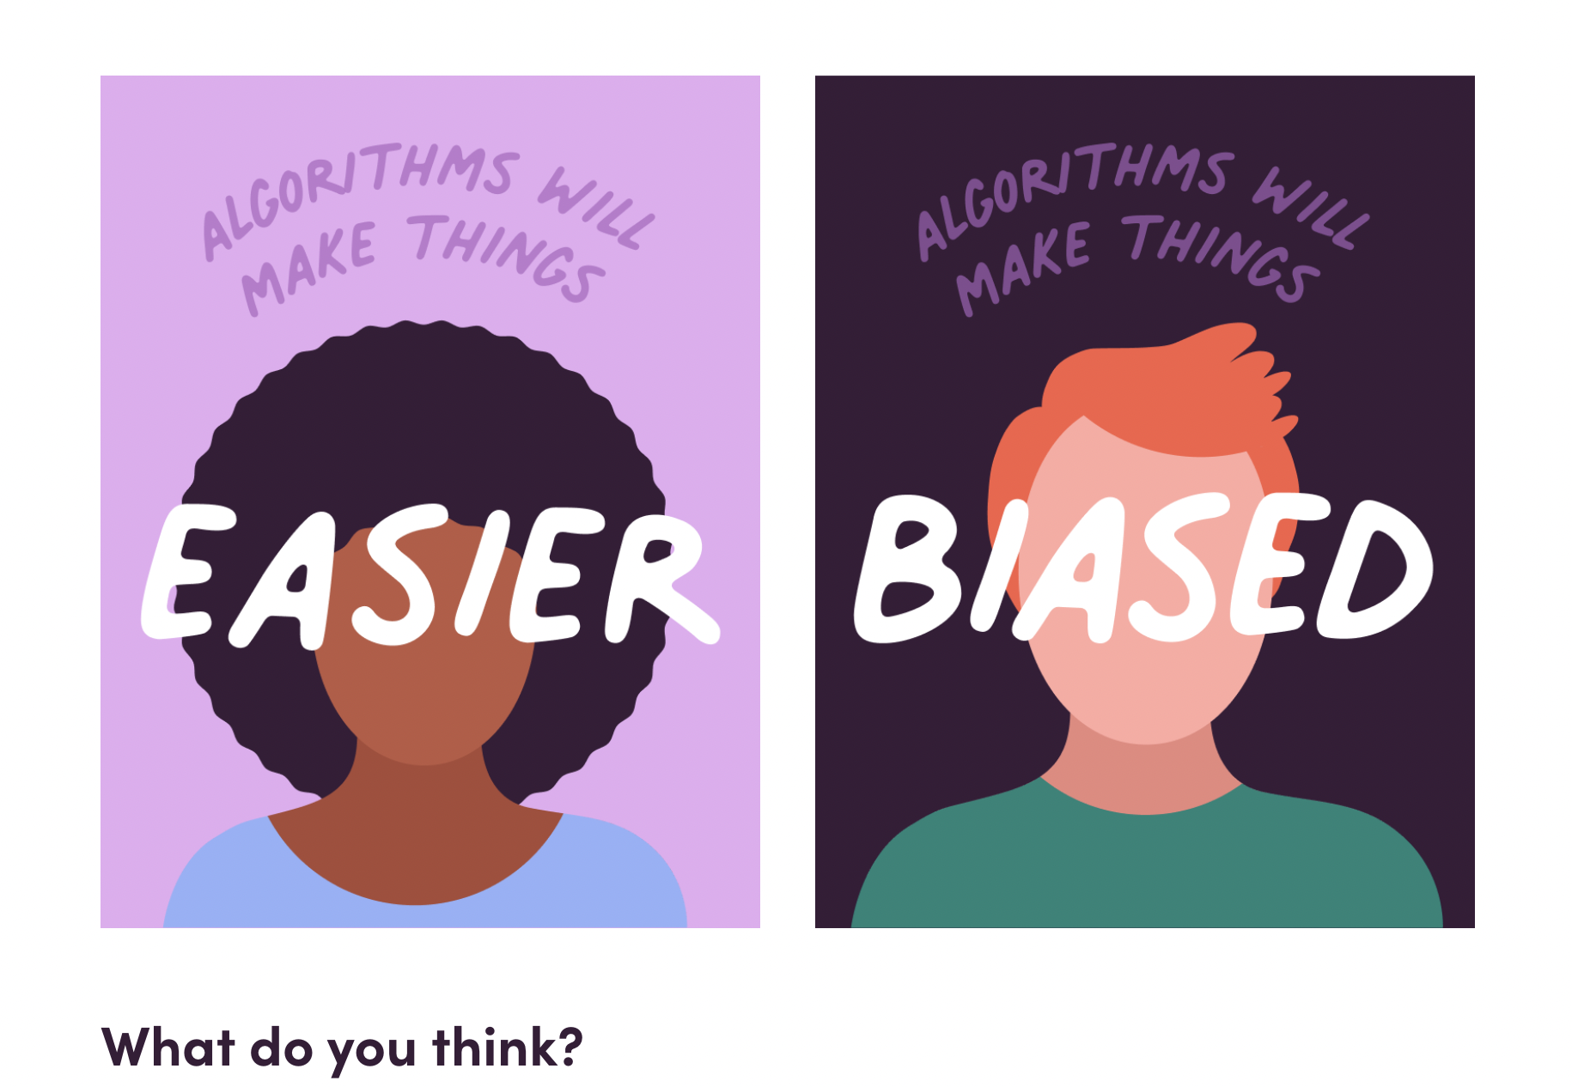
Algo the Robot website game

Slide 6
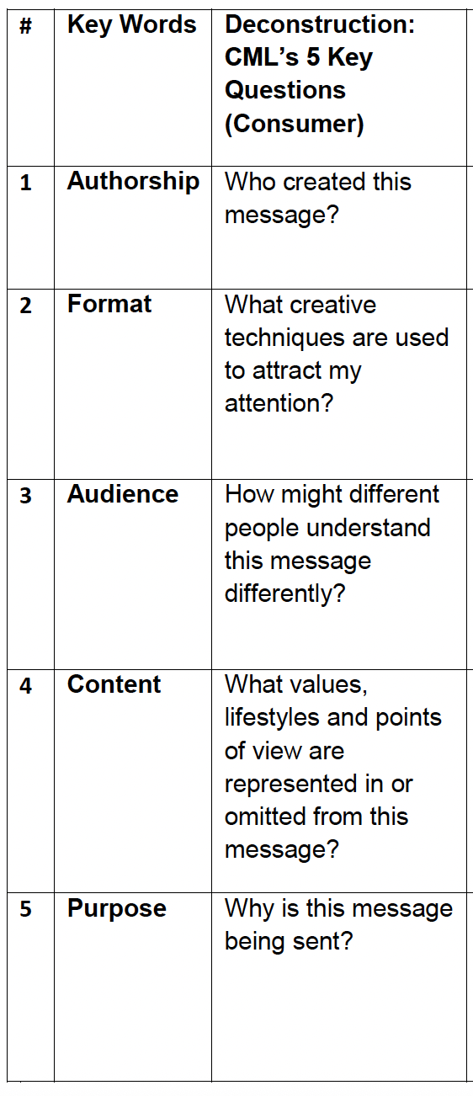
Analyze the song using the Center for Media Literacy’s 5 key media literacy questions →
What does this message want to you do, feel, think or believe?
Why was this message sent?
What words in the lyrics make the most impact on you? Why? Describe the mood set by the music. Does it fit the lyrics?

Slide 7
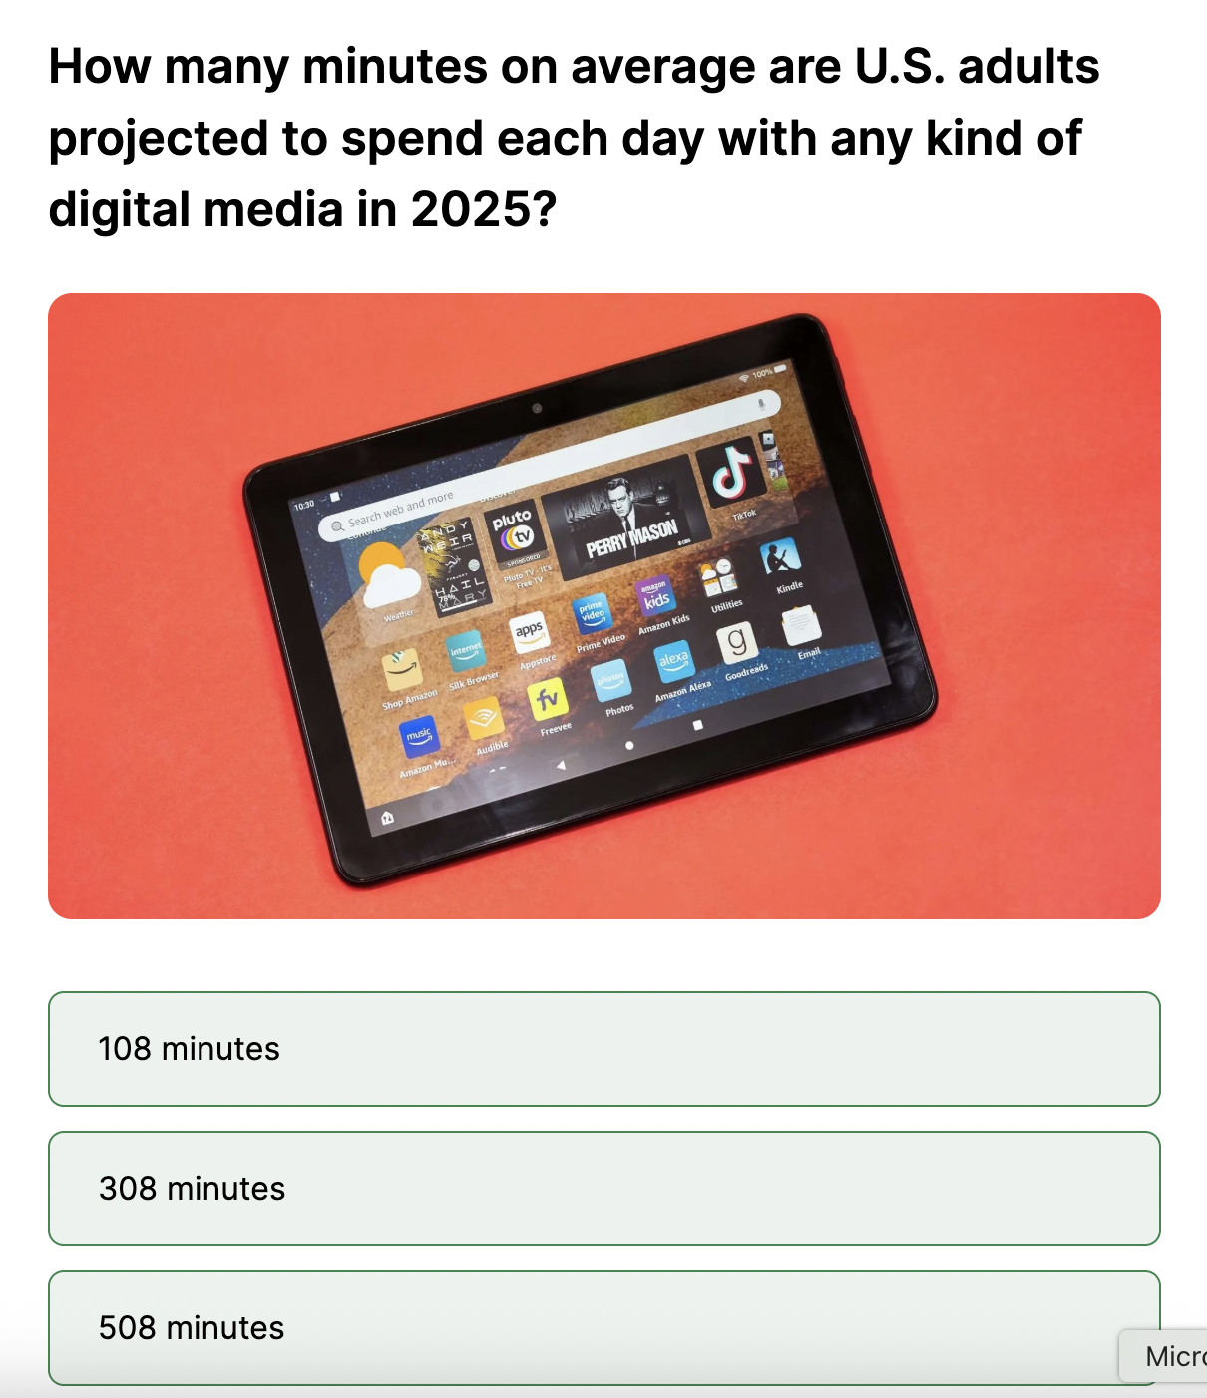
Play the “Daily Media Use” game at WonderMediaLibrary.org and consider what you do online instead of connecting IRL with friends and family as this song describes.

